Slide 1
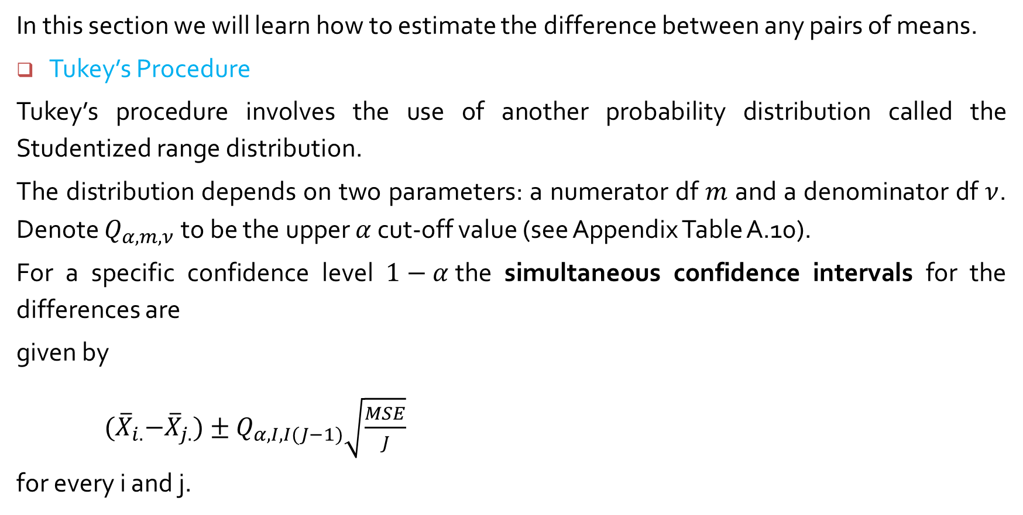
10.2 Multiple Comparisons in ANOVA
In this section we will learn how to estimate the difference between any pairs of means.
Tukey’s Procedure
Tukey’s procedure involves the use of another probability distribution called the Studentized range distribution.
The distribution depends on two parameters: a numerator df $m$ and a denominator df $ν$. Denote $Q_{α, m,ν}$to be the upper $α$ cut-off value (see Appendix Table A.10).
For a specific confidence level $1−α$the simultaneous confidence intervals for the differences are
given by
${(\overline{X}}_{i.}−{\overline{X}}_{j.})±Q_{α, I,I(J−1)}\sqrt{\frac{MSE}{J}}$
for every i and j.

Slide 2
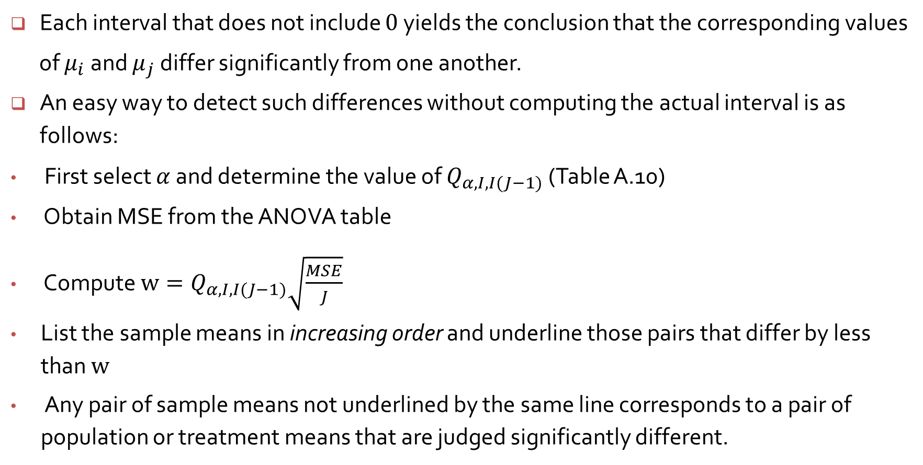
Each interval that does not include $0$yields the conclusion that the corresponding values
of $μ_{i}$and $μ_{j}$ differ significantly from one another.
An easy way to detect such differences without computing the actual interval is as follows:
First select $α$ and determine the value of $Q_{α, I,I(J−1)}$(Table A.10)
Obtain MSE from the ANOVA table
Compute $w=Q_{α, I,I(J−1)}\sqrt{\frac{MSE}{J}}$
List the sample means in increasing order and underline those pairs that differ by less than $w$
Any pair of sample means not underlined by the same line corresponds to a pair of population or treatment means that are judged significantly different.

Slide 3
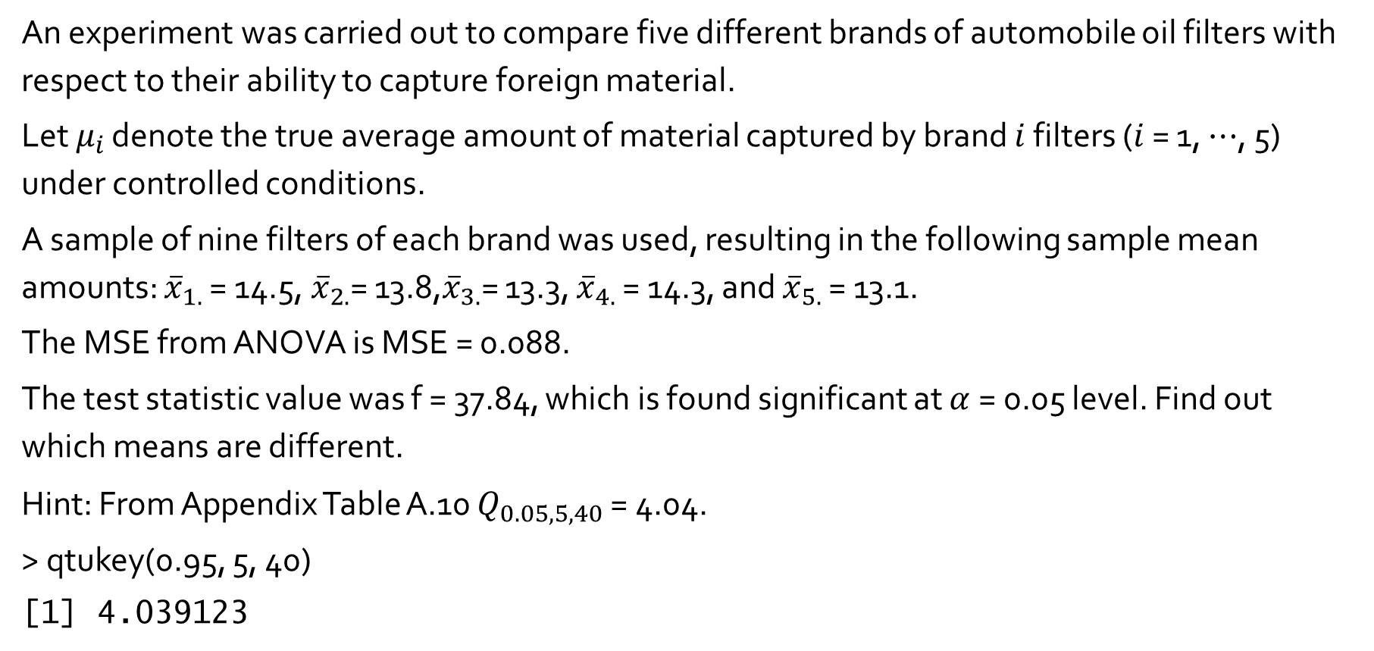
Example 10.5
An experiment was carried out to compare five different brands of automobile oil filters with respect to their ability to capture foreign material.
Let $μ_{i }$denote the true average amount of material captured by brand $i$ filters ($i$ = 1, $⋯$, 5) under controlled conditions.
A sample of nine filters of each brand was used, resulting in the following sample mean amounts: ${\overline{x}}_{1.}$ = 14.5,${ \overline{x}}_{2.}$= 13.8,${\overline{x}}_{3.}$= 13.3, ${\overline{x}}_{4.}$ = 14.3, and ${\overline{x}}_{5.}$ = 13.1.
The MSE from ANOVA is MSE = 0.088.
The test statistic value was f = 37.84, which is found significant at $α$= 0.05 level. Find out which means are different.
Hint: From Appendix Table A.10 $Q_{0.05, 5, 40}$ = 4.04.
> qtukey(0.95, 5, 40)
[1] 4.039123

Slide 4
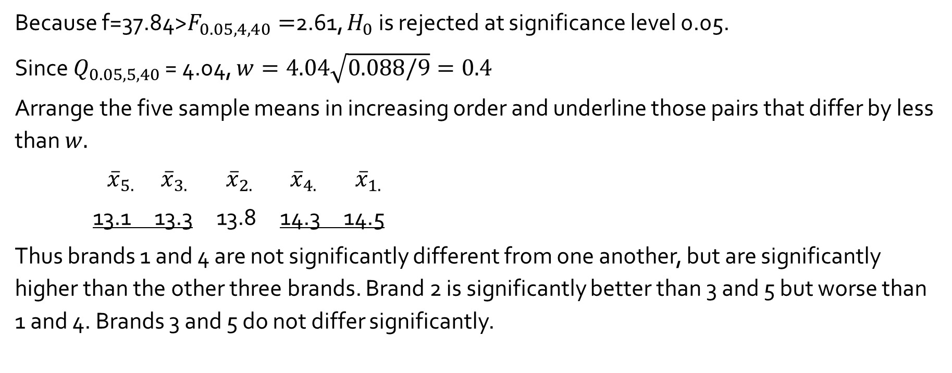
Source of Variation | df | Sum of Squares | Mean Square | f
Treatments Error Total | 4 40 44 | 13.32 3.53 16.85 | 3.33 0.088 | 37.84
Because f=37.84>$F_{0.05, 4, 40}=$2.61, $H_{0}$ is rejected at significance level 0.05.
Since $Q_{0.05, 5, 40}$ = 4.04, $w=4.04\sqrt{0.088/9}=0.4$
Arrange the five sample means in increasing order and underline those pairs that differ by less than $w.$
${\overline{x}}_{5.} {\overline{x}}_{3.}$ ${\overline{x}}_{2.} {\overline{x}}_{4.}$ ${\overline{x}}_{1.}$
13.1 13.3 13.8 14.3 14.5
Thus brands 1 and 4 are not significantly different from one another, but are significantly higher than the other three brands. Brand 2 is significantly better than 3 and 5 but worse than 1 and 4. Brands 3 and 5 do not differ significantly.

Slide 5
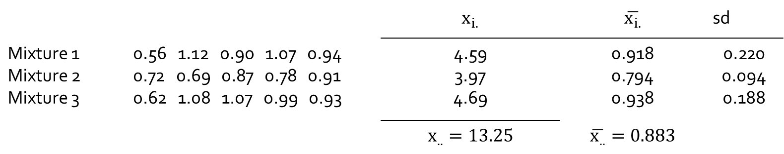

Example 10.4
The accompanying data shows the degree of soiling for fabric copolymerized with three different mixtures of methacrylic acid.
$H_{0} : μ_{1}=μ_{2}= μ_{3}$ vs $H_{a}$ : At least two group means are different
 |  | $$x_{i.}$$ | $$\overline{x_{i.}}$$ | sd
Mixture 1 Mixture 2 Mixture 3 | 0.56 1.12 0.90 1.07 0.94 0.72 0.69 0.87 0.78 0.91 0.62 1.08 1.07 0.99 0.93 | 4.59 3.97 4.69 | 0.918 0.794 0.938 | 0.220 0.094 0.188
 |  | $$x_{..}=13.25$$ | $$\overline{x_{..}}=0.883$$

Slide 6
Tukey’s Comparison : Example 10.4
> degree <- c(0.56, 1.12, 0.90, 1.07, 0.94,
+ 0.72, 0.69, 0.87, 0.78, 0.91,
+ 0.62, 1.08, 1.07, 0.99, 0.93)
> type <- c(rep("1", 5), rep("2", 5), rep("3", 5))
> oneway <- aov(degree ~ type)
> summary(oneway)
> posthoc <- TukeyHSD(x=oneway, 'type', conf.level=0.95)
> posthoc
diff lwr upr p adj
2-1 -0.124 -0.4203131 0.1723131 0.5225991
3-1 0.020 -0.2763131 0.3163131 0.9823093
3-2 0.144 -0.1523131 0.4403131 0.4235977

Slide 7
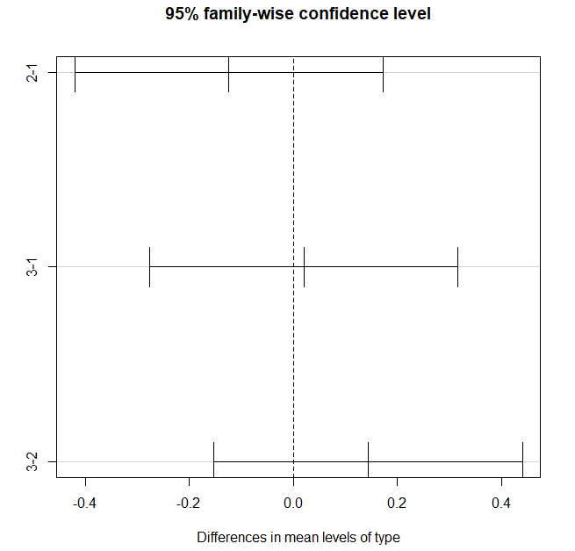
> plot(posthoc)

Slide 8
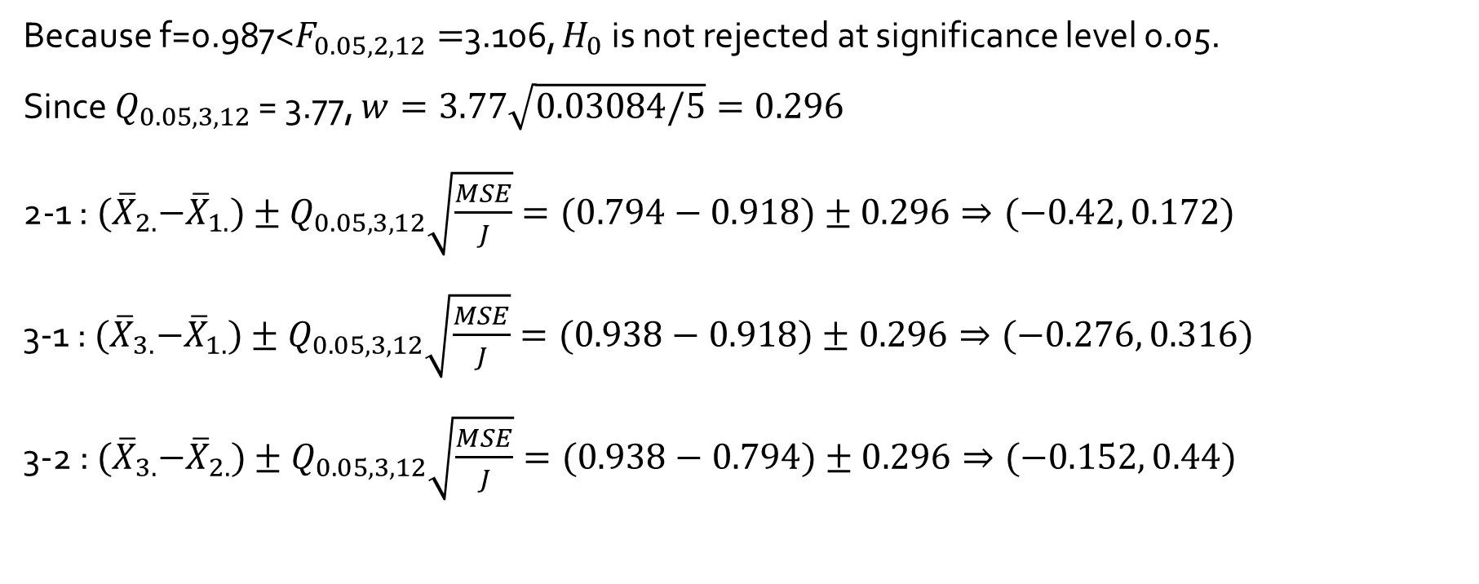
Source of Variation | df | Sum of Squares | Mean Square | f
type Error Total | 2 12 14 | 0.0609 0.3701 0.4310 | 0.03043 0.03084 | 0.987
Because f=0.987<$F_{0.05, 2, 12}=$3.106, $H_{0}$ is not rejected at significance level 0.05.
Since $Q_{0.05, 3, 12}$ = 3.77, $w=3.77\sqrt{0.03084/5}=0.296$
2-1 : ${(\overline{X}}_{2.}−{\overline{X}}_{1.})±Q_{0.05, 3,12}\sqrt{\frac{MSE}{J}}=(0.794−0.918)±0.296⇒(−0.42, 0.172)$
3-1 : ${(\overline{X}}_{3.}−{\overline{X}}_{1.})±Q_{0.05, 3,12}\sqrt{\frac{MSE}{J}}=(0.938−0.918)±0.296⇒(−0.276, 0.316)$
3-2 : ${(\overline{X}}_{3.}−{\overline{X}}_{2.})±Q_{0.05, 3,12}\sqrt{\frac{MSE}{J}}=(0.938−0.794)±0.296⇒(−0.152, 0.44)$

